Slide 1
Restaurant Review Sentiment Analysis
Using NLP and Machine Learning to classify customer reviews and extract business insights.
By: Hellen Otieno

Slide 2
Business Problem
Restaurants receive large volumes of reviews. Manual analysis is inefficient.
Goal: Automatically classify sentiment and extract insights.

Slide 3
Approach
Text preprocessing
Bag of Words
Decision tree, KNN, Naive Bayes model, Random Forest
Model evaluation
SHAP explainability
Word cloud visualisation

Slide 4
Model Performance
Best Model: Naïve Bayes
Accuracy: ~76%
ROC AUC: ~0.84
Balanced precision and recall across classes

Slide 5
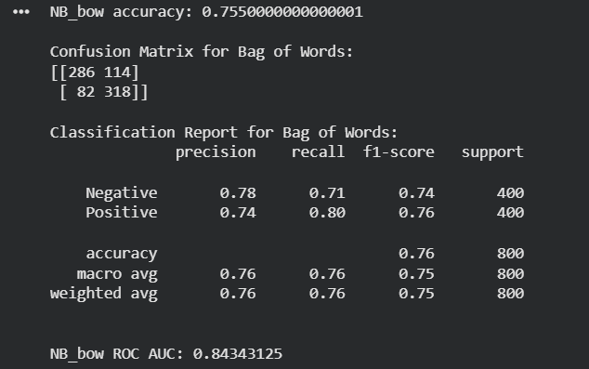
Model Evaluation Metrics

Slide 6
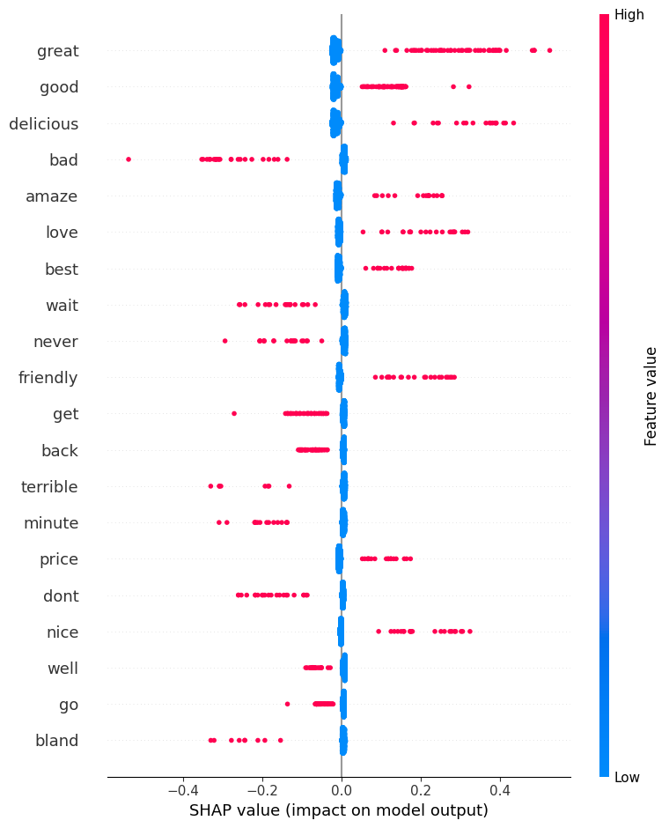
SHAP Interpretation

Slide 7
SHAP Interpretation Summary
The SHAP summary plot shows how individual words influence the model’s sentiment predictions. Words positioned on the right push predictions toward positive sentiment, while those on the left push toward negative sentiment.
The model strongly associates words like “great,” “good,” “delicious,” and “love” with positive reviews, while words such as “bad,” “terrible,” “wait,” and “bland” drive negative predictions.
Additionally, the spread of points for each word indicates that their impact can vary depending on context, but overall, the model captures clear and intuitive patterns in customer feedback.
In short, the visualisation confirms that the model is making decisions based on meaningful and interpretable language signals.

Slide 8
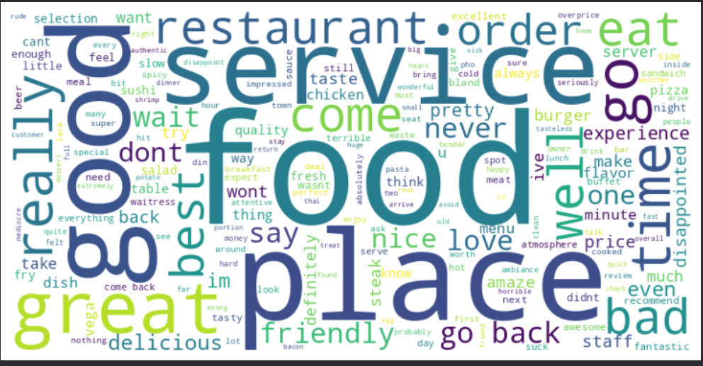
Overall Word Distribution

Slide 9
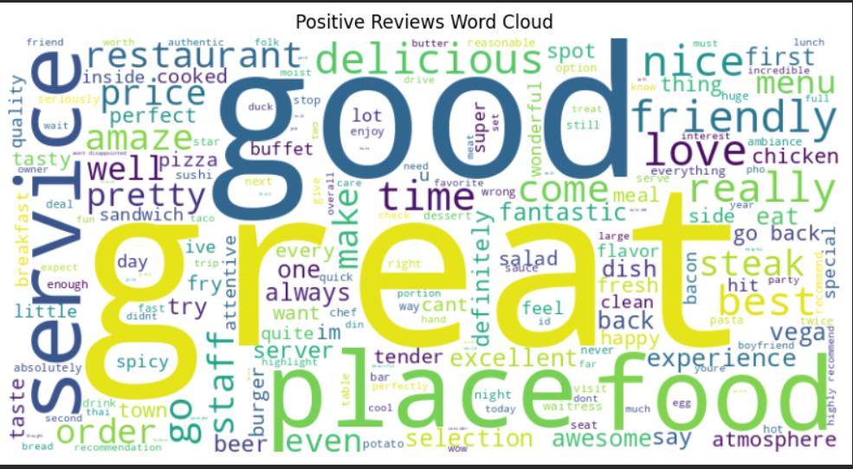
Positive Reviews Word Cloud

Slide 10
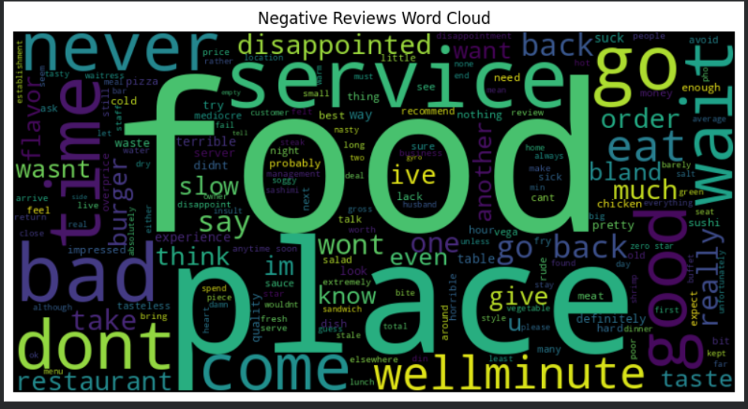
Negative Reviews Word Cloud

Slide 11
Key Insights
• Positive words: great, delicious, friendly
• Negative words: bad, terrible, wait
• Model captures meaningful sentiment patterns

Slide 12
Conclusion
This project shows how NLP can turn customer feedback into actionable insights for businesses.

